Slide 1

Database Management System Lecture 4
Engr. Dr SAIMA WASEEM
School of Systems and Technology (SST)
Artificial Intelligence Faculty

Slide 2
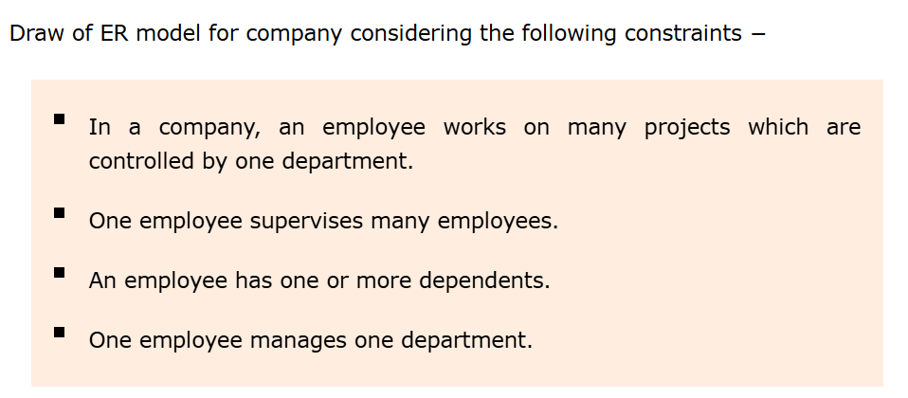

Slide 3
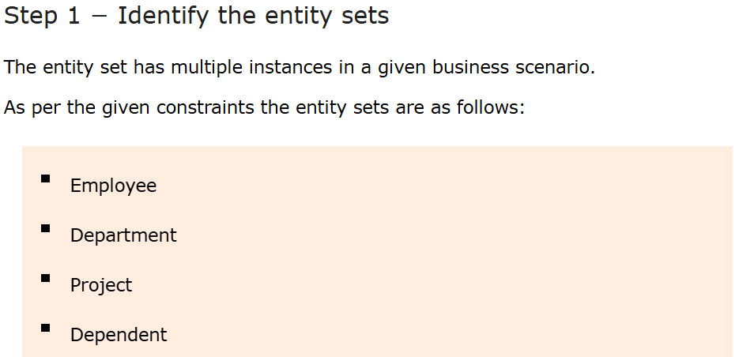

Slide 4
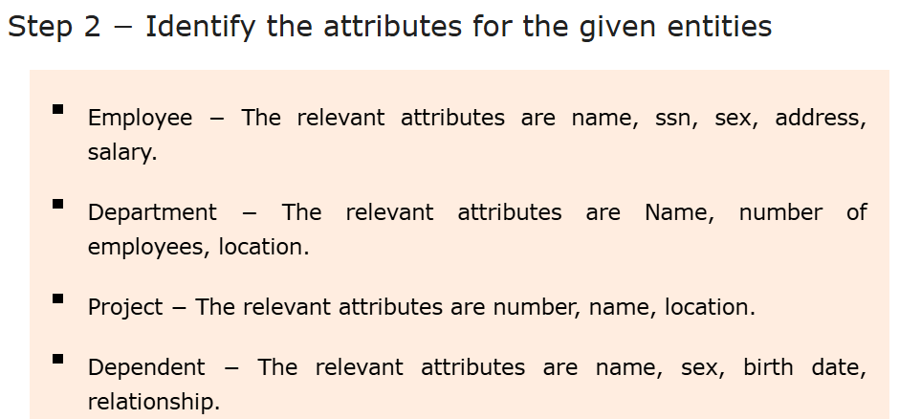

Slide 5
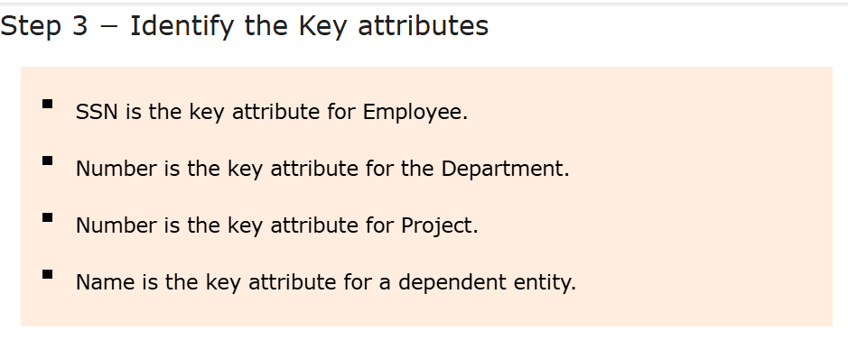

Slide 6
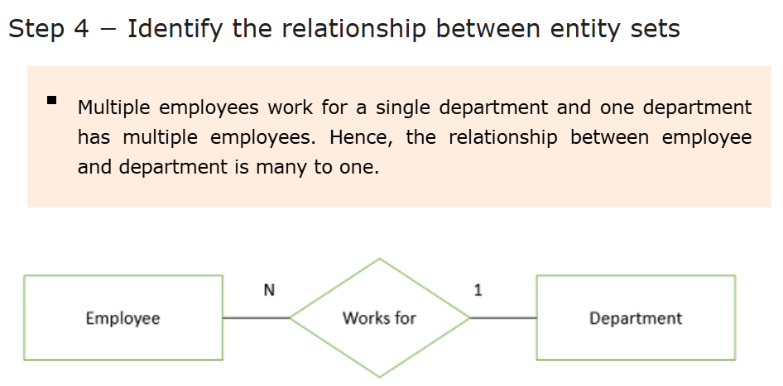

Slide 7
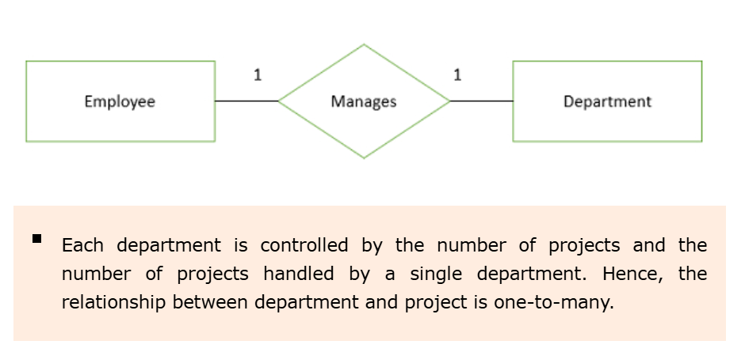

Slide 8


Slide 9
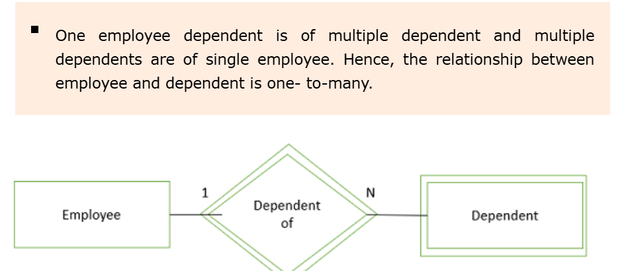

Slide 10
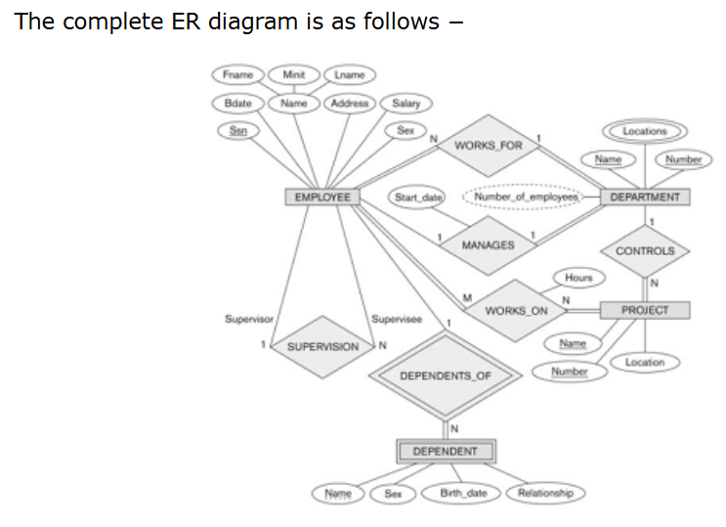

Slide 11
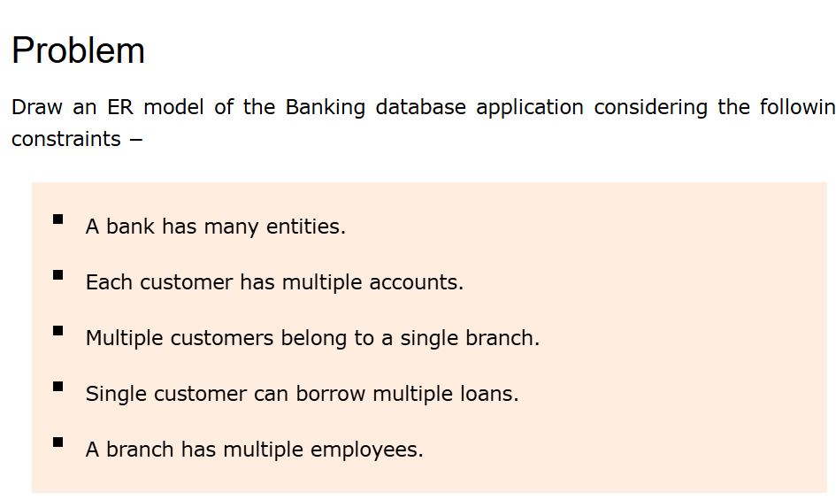

Slide 12
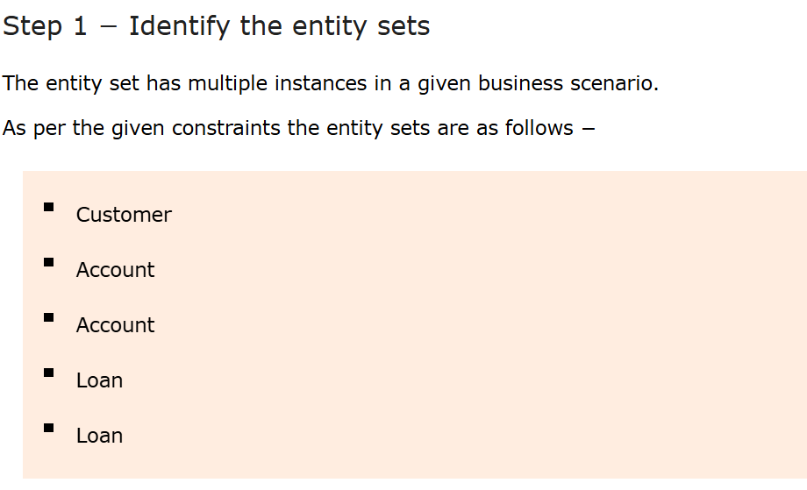

Slide 13
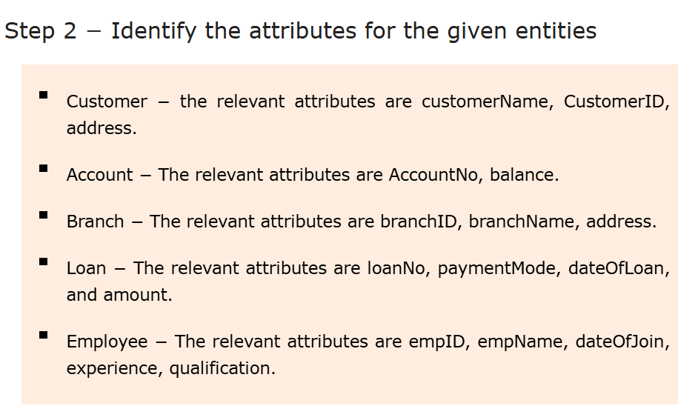

Slide 14
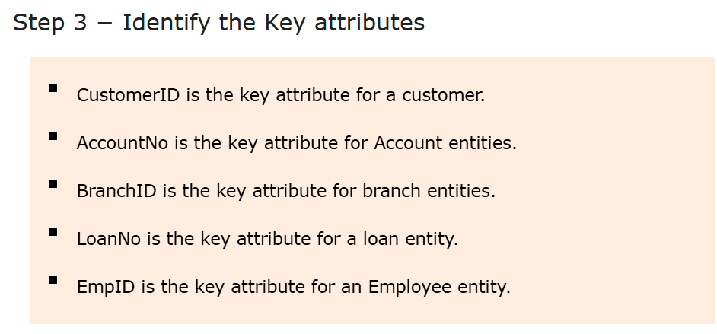

Slide 15
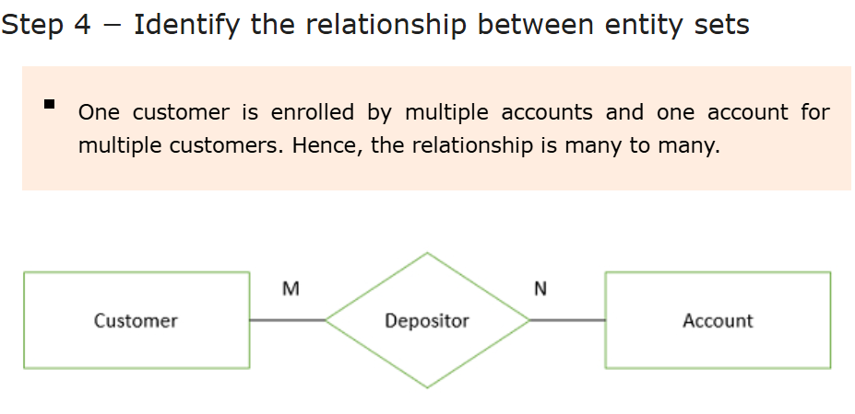

Slide 16
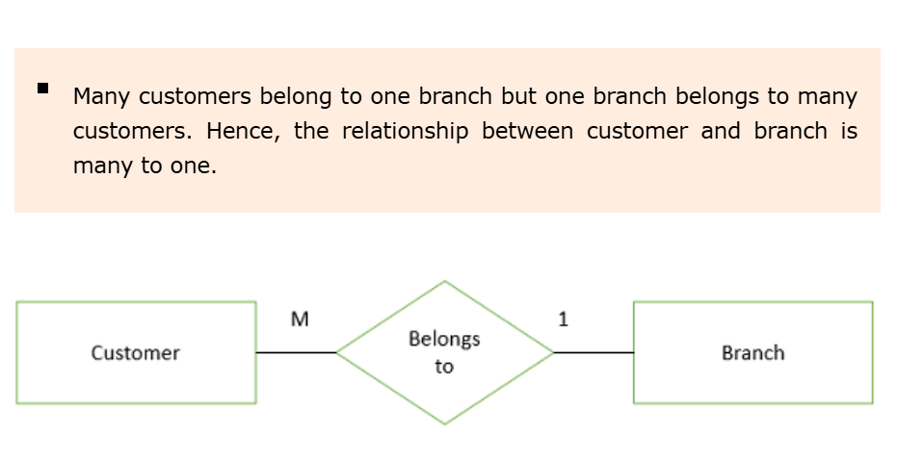

Slide 17
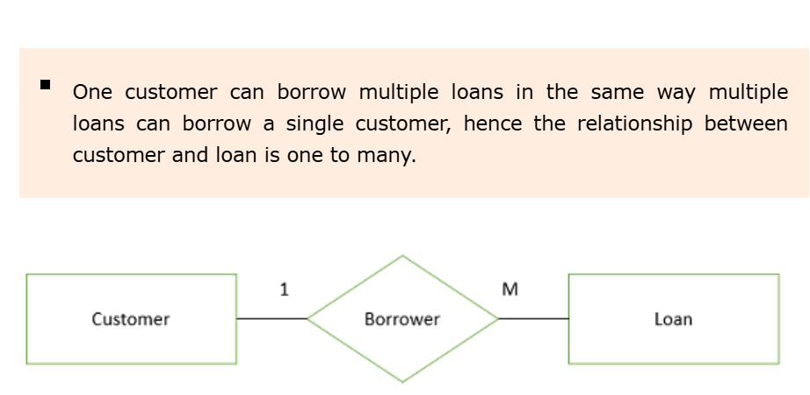

Slide 18
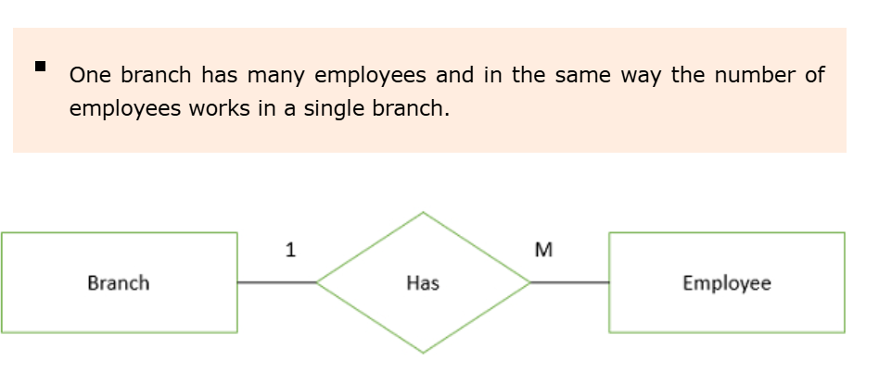

Slide 19
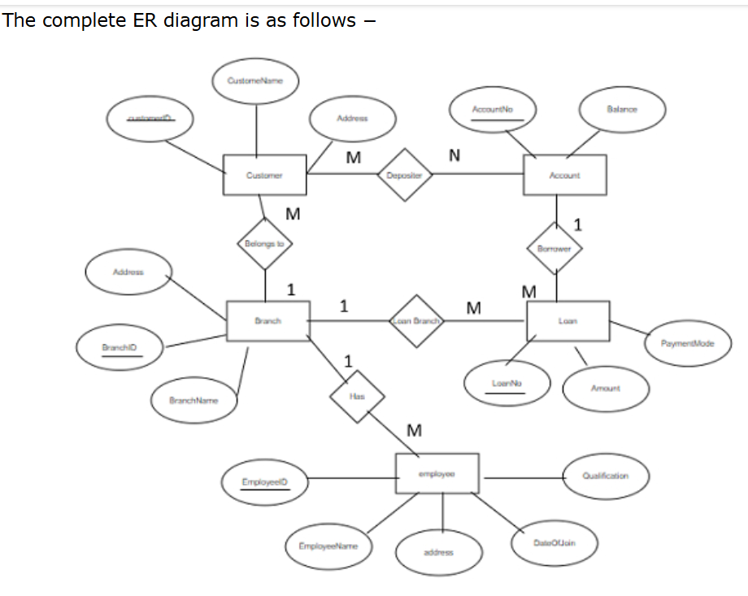

Slide 20
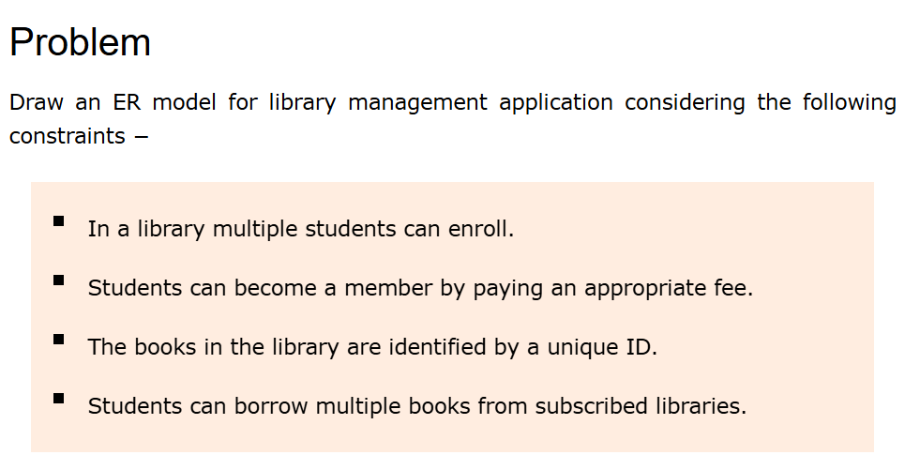

Slide 21
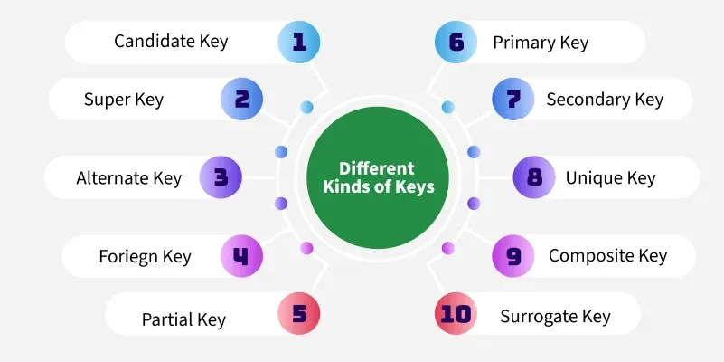
Keys in Relational Model

Slide 22
Keys in Relational Model
Keys are fundamental components that ensure data integrity, uniqueness and efficient access. It is widely used to identify the tuples(rows) uniquely in the table.
We also use keys to set up relations amongst various columns and tables of a relational database.

Slide 23
Why do we require Keys in a DBMS?
Uniqueness: Keys ensure that each record in a table is unique and can be identified distinctly.
Data Integrity: Keys prevent data duplication and maintain the consistency of the data.
Efficient Data Retrieval: By defining relationships between tables, keys enable faster querying and better data organization. Without keys, it would be extremely difficult to manage large datasets and queries would become inefficient and prone to errors.

Slide 24
Super Key
A Super Key in DBMS is a group of one or more attributes in a table that can uniquely identify every row in that table. It ensures no two rows have the same combination of values for those attributes.

Slide 25
Key Features of Super Key in DBMS
Uniqueness: A super key ensures that every row in a table is uniquely identified and prevents duplicate records.
One or More Attributes: It can consist of a single column or a combination of multiple columns.
Not Necessarily Minimal: A super key may include extra attributes that are not required for uniqueness, unlike a candidate key.
Includes Primary Key and Candidate Keys: Every primary key and candidate key is a super key, but not all super keys are primary keys or candidate key.

Slide 26
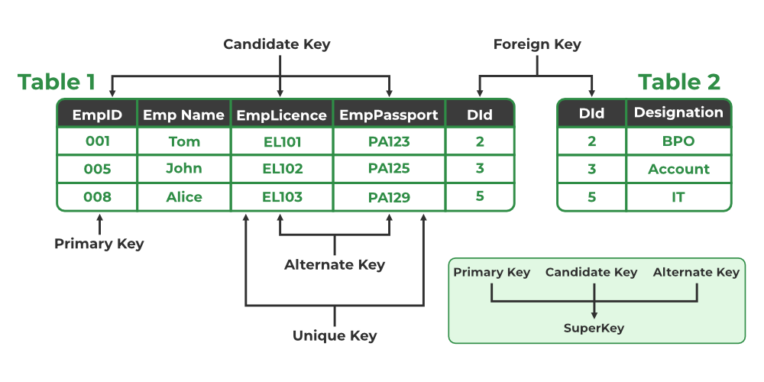

Slide 27
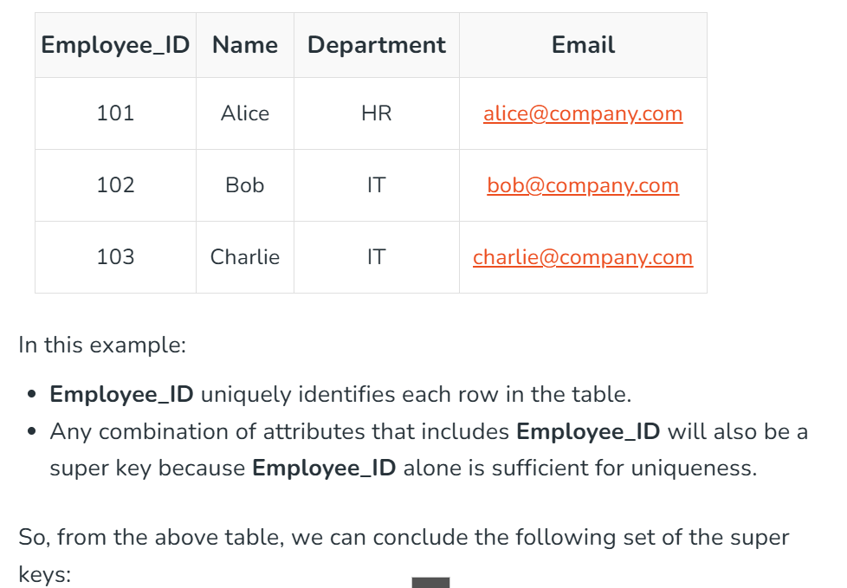

Slide 28
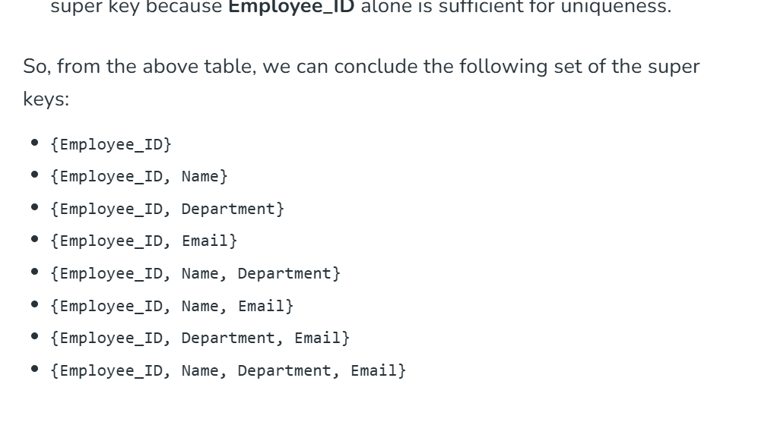

Slide 29
How to Identify a Super Key in a Database Table
1. Understand the Table
Think about which column or combination of columns can uniquely identify each row in the table.
2. Start with Single Columns
Check if any single column can uniquely identify every row.
(Example: Columns like Student_ID or Employee_ID are often unique.)
If one column is enough, it is a super key.
3. Combine Columns if Needed
4. Include Extra Columns
Remember, a super key can include extra columns that are not necessary for uniqueness.
Example: {Employee_ID, Name} is a super key because it includes Employee_ID, which is already unique.

Slide 30
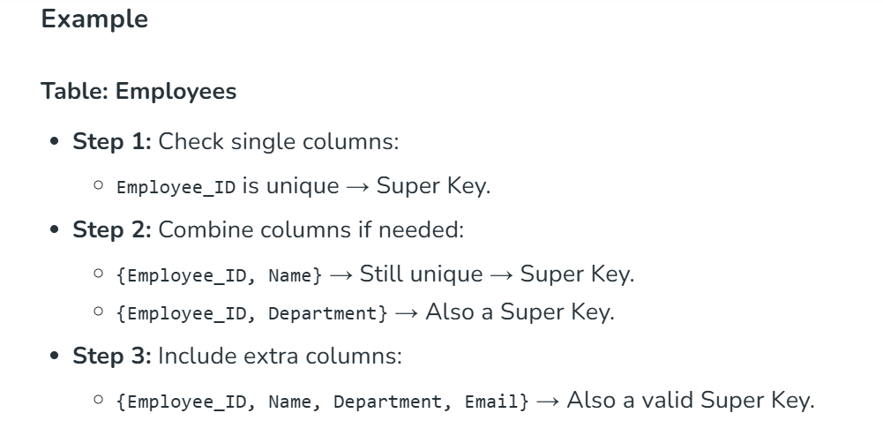

Slide 31
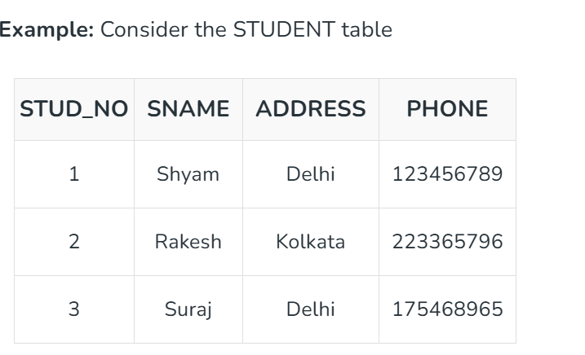

Slide 32
Candidate Key
A candidate key is a minimal set of attributes that uniquely identifies each tuple within a table. In other words, there should not be any two rows in a table that can have the same values for the columns that are the part of candidate key. Candidate key is a subset of Super key. It is very important for establishing relationships between tables and maintaining data integrity. Candidate keys play a pivotal role in database normalization as they help us to eliminate data redundancy and anomalies.

Slide 33
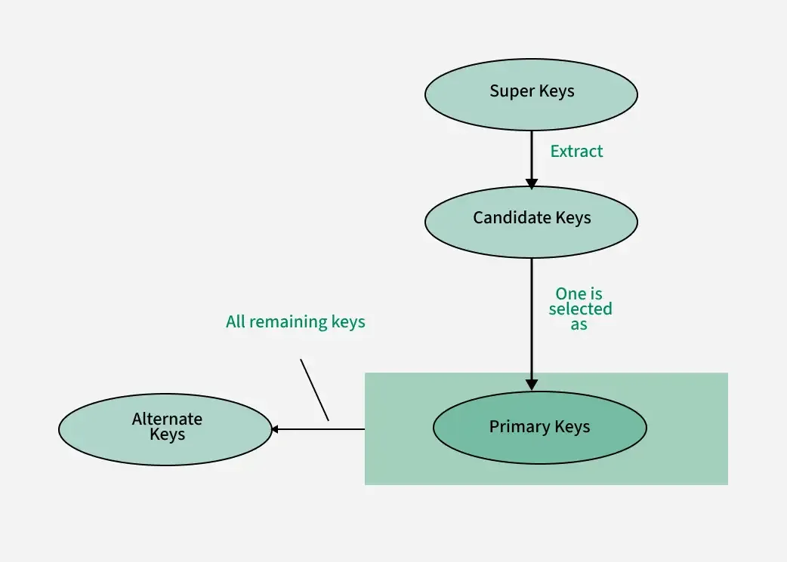

Slide 34
Key Features of Candidate Key in DBMS
A candidate key has unique values for every row in a table.
Every candidate key is a super key, but not all super keys qualify as candidate keys. Simply put, a candidate key is a minimal super key.
A candidate key can contain null values, but this depends on the database's design and constraints.
It should not have redundant attributes, meaning it must be as simple as possible to uniquely identify a row.
Using a candidate key, we can uniquely determine the values of all other attributes in a table.
The primary key is chosen from the set of candidate keys.

Slide 35
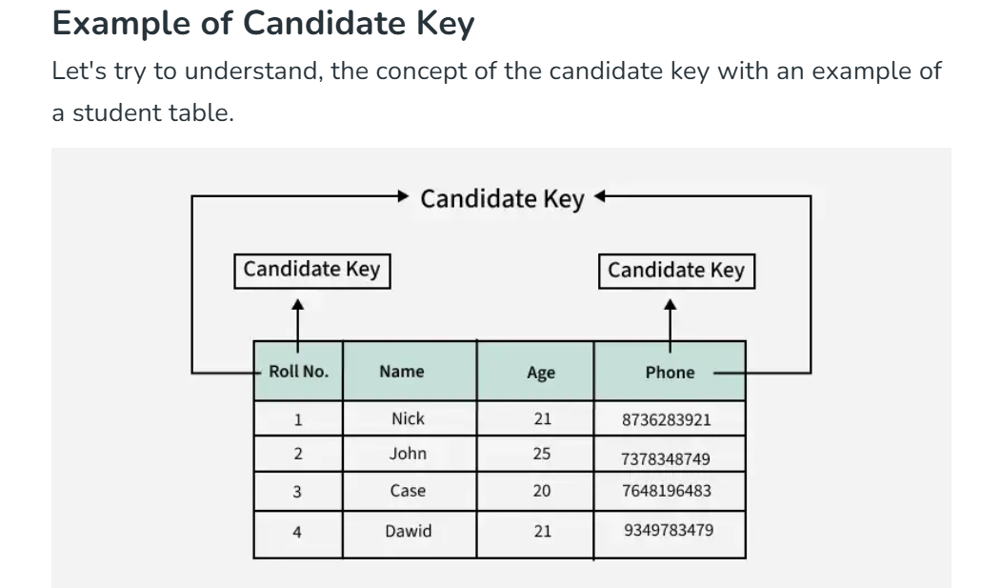

Slide 36
How to Identify a Candidate Key in a Database Table?
Method 1: Checking Unique Columns or Sets of Columns
Method 2: Using Functional Dependencies (FDs) In this approach, the functional dependencies between attributes are used to identify candidate keys. A functional dependency exists when one attribute determines another. For instance, if a table has student_ID and student_name, there is a functional dependency where student_ID determines student_name. The candidate key is found by identifying the smallest set of attributes that can determine all other attributes in the table.
Method 3: Using Normal Forms

Slide 37
Aspect | Super Key | Candidate Key
Definition | A set of one or more attributes that uniquely identifies a row in a table. | A minimal super key that uniquely identifies a row (no unnecessary fields).
Uniqueness | Ensures row uniqueness. | Ensures row uniqueness efficiently (with only needed attributes).
Minimality | May contain extra/unnecessary attributes. | Always minimal – no extra attributes.
Subset Relation | Every candidate key is a super key. | Not every super key is a candidate key.
Quantity | A table can have many super keys. | A table can have one or more candidate keys.
Examples | {Employee_ID}, {Employee_ID, Name}, etc. | {Employee_ID} only (if minimal and unique).
Use in Schema Design | Broad identifier set, not always used directly. | From candidate keys, one is chosen as the primary key.

Slide 38
Primary Key
There can be more than one candidate key in relation out of which one can be chosen as the primary key. For Example, STUD_NO, as well as STUD_PHONE, are candidate keys for relation STUDENT but STUD_NO can be chosen as the primary key (only one out of many candidate keys).

Slide 39
Rules For Defining a Primary Key
Minimal: The primary key is composed of a minimum number of attributes that satisfy the unique occurrence of the tuples or records. So if one candidate key is formed using two attributes and the other using a single attribute then the one with a single attribute key should be chosen as the primary key.
Accessible: The primary key is used to check the ability to access and interact with the database. The user must easily create, read or delete a tuple using it.

Slide 40
Rules For Defining a Primary Key
NON NULL Value: The primary key which refers to a nonnull value that is required for the identification of the tuple (record) means that any attribute can not contain the non-null value in DBMS.
Time Invariant: The values of the primary key must not change or become null during the lifetime of the relation. For example, we cannot choose the name attribute of the EMPLOYEE Relation as a primary key because there is no guarantee that two employees with the same name will never exist.
Unique: The primary key in which value can not be duplicated in any of the rows or tuples of the relation.
Composite Keys (if used): If a composite key (primary key with multiple attributes) is used, ensure that the combination of attributes uniquely identifies a record and remains minimal (no unnecessary attributes included).

Slide 41
Alternate Key
An alternate key is any candidate key in a table that is not chosen as the primary key. In other words, all the keys that are not selected as the primary key are considered alternate keys.
An alternate key is also referred to as a secondary key because it can uniquely identify records in a table, just like the primary key.
An alternate key can consist of one or more columns (fields) that can uniquely identify a record, but it is not the primary key

Slide 42
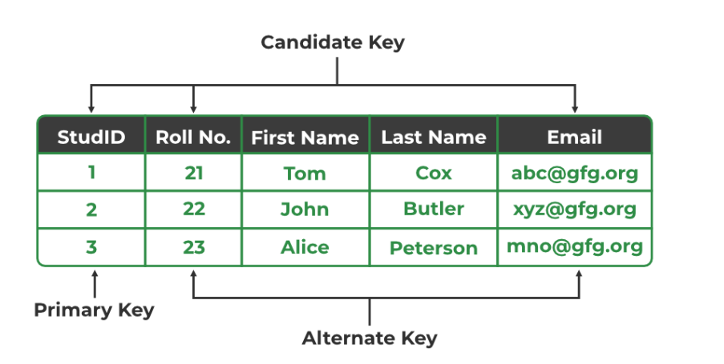

Slide 43
Foreign Key
A foreign key is an attribute in one table that refers to the primary key in another table. The table that contains the foreign key is called the referencing table and the table that is referenced is called the referenced table.
A foreign key in one table points to the primary key in another table, establishing a relationship between them.
It helps connect two or more tables, enabling you to create relationships between them. This is important for maintaining data integrity and preventing data redundancy.
They act as a cross-reference between the tables.

Slide 44
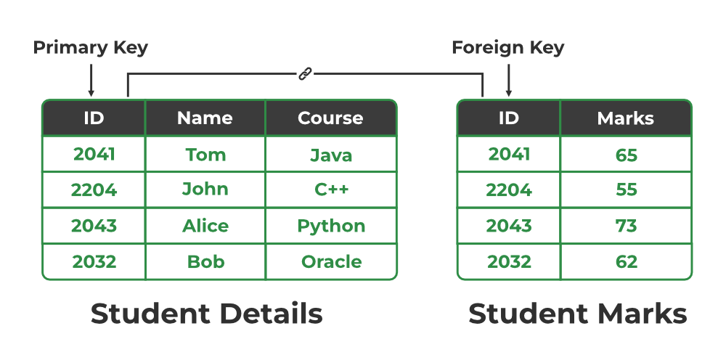

Slide 45
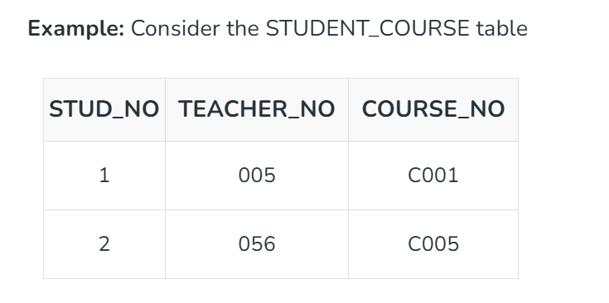
Explanation:
Here, STUD_NO in the STUDENT_COURSE table is a foreign key that references the STUD_NO primary key in the STUDENT table.
Unlike the Primary Key of any given relation, Foreign Key can be NULL as well as may contain duplicate tuples i.e. it need not follow uniqueness constraint. For Example, STUD_NO in the STUDENT_COURSE relation is not unique.
It has been repeated for the first and third tuples. However, the STUD_NO in STUDENT relation is a primary key and it needs to be always unique and it cannot be null.

Slide 46
Composite Key
Sometimes, a table might not have a single column/attribute that uniquely identifies all the records of a table. To uniquely identify rows of a table, a combination of two or more columns/attributes can be used. It still can give duplicate values in rare cases. So, we need to find the optimal set of attributes that can uniquely identify rows in a table.
It acts as a primary key if there is no primary key in a table
Two or more attributes are used together to make a composite key .
Different combinations of attributes may give different accuracy in terms of identifying the rows uniquely.

Slide 47
Example: In the STUDENT_COURSE table, {STUD_NO, COURSE_NO} can form a composite key to uniquely identify each record.

Slide 48
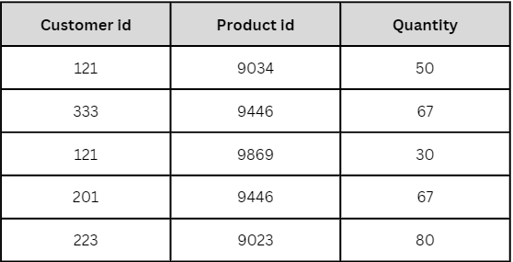

Slide 50
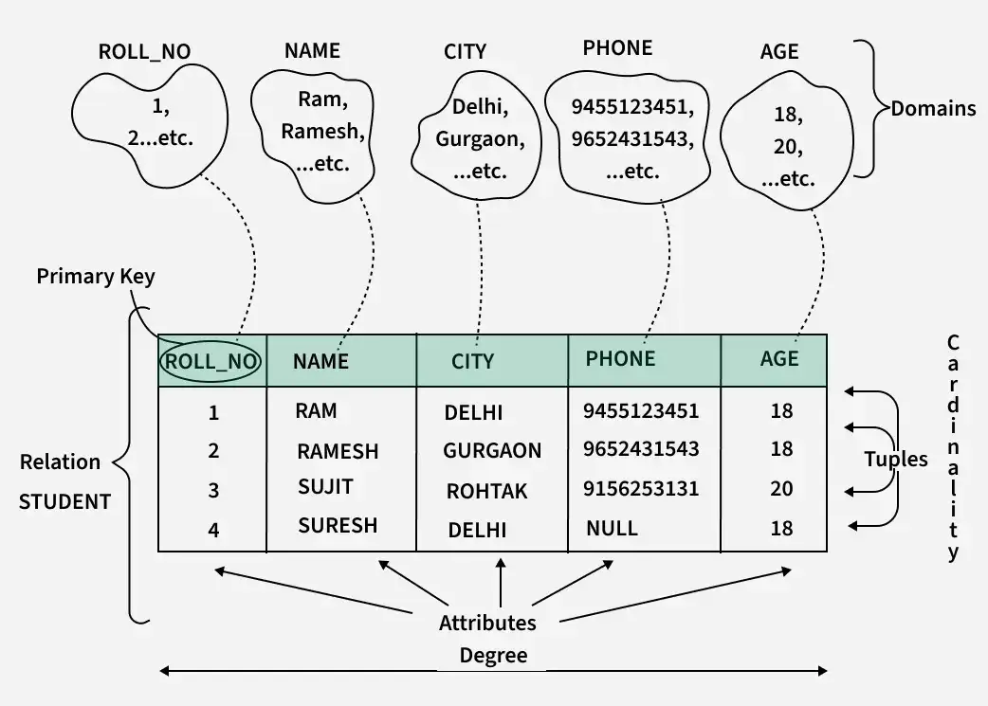

Slide 51
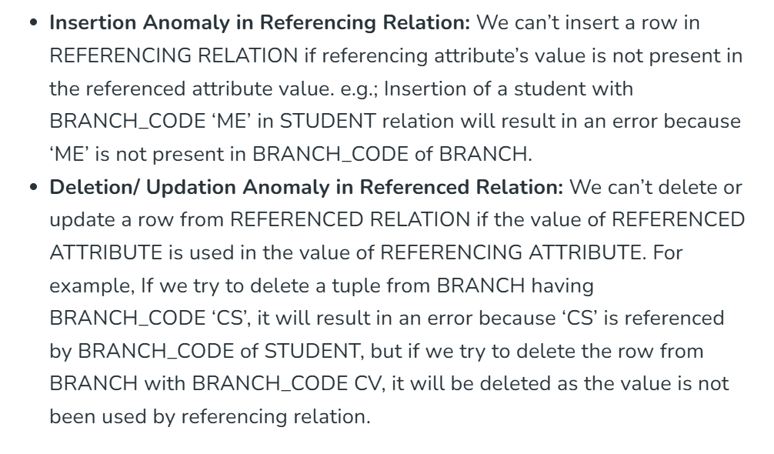
Anomalies in the Relational Model

Slide 52
Mapping from ER Model to Relational Model
Converting an Entity-Relationship (ER) diagram to a Relational Model is a crucial step in database design. The ER model represents the conceptual structure of a database, while the Relational Model is a physical representation that can be directly implemented using a Relational Database Management System (RDBMS) like Oracle or MySQL.

Slide 53
Minimization of ER Diagrams
Minimization of ER Diagram simply means reducing the number of the tables in the ER Diagram. When there are so many tables present in the ER Diagram, it decreases its readability and understandability, and it also becomes difficult for the admin also to understand these. Minimizing the ER Diagram helps in better understanding. We reduce tables depending on the cardinality.

Slide 54
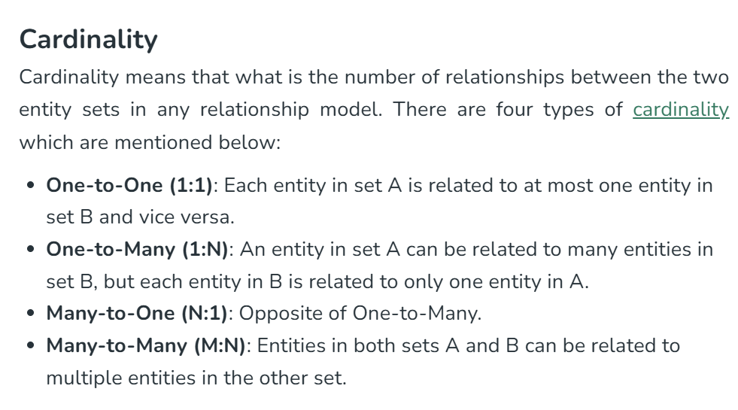

Slide 55
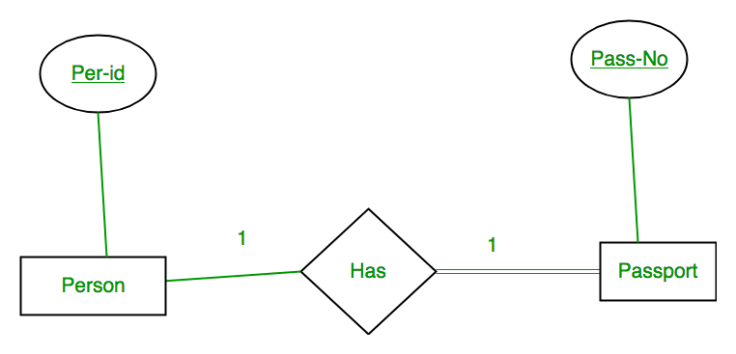
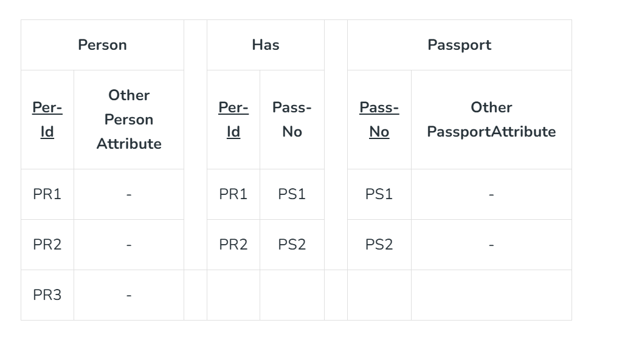

Slide 56


Slide 58

As we can see from Table 1, each Per-Id and Pass-No has only one entry in Has Table. So we can merge all three tables into 1 with attributes shown in Table 2. Each Per-Id will be unique and not null. So it will be the key. Pass-No can’t be key because for some person, it can be NULL.

Slide 59
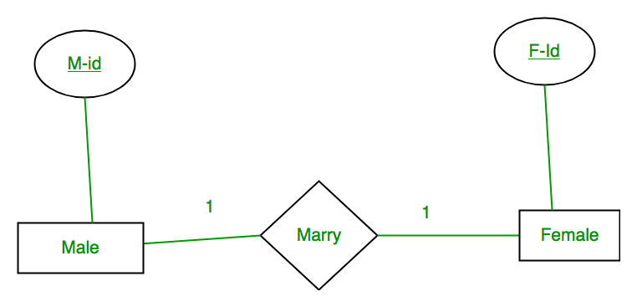
Case 2: Binary Relationship with 1:1 cardinality and partial participation of both entities

Slide 60
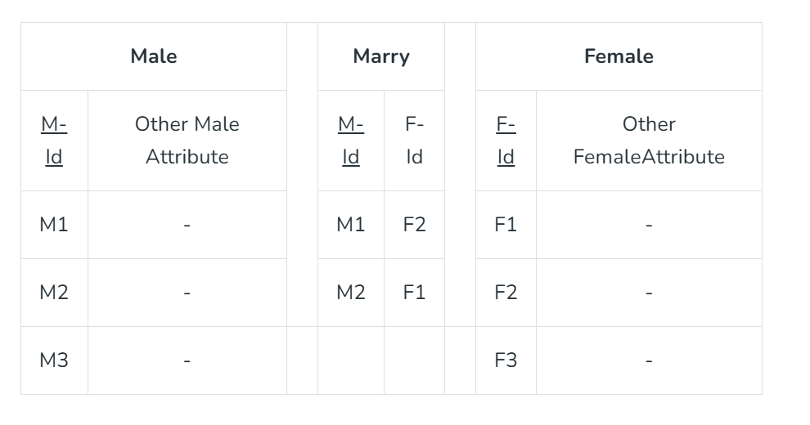
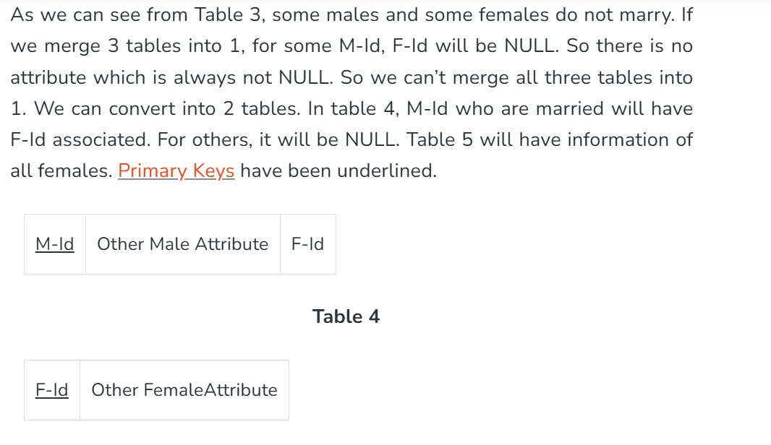

Slide 61
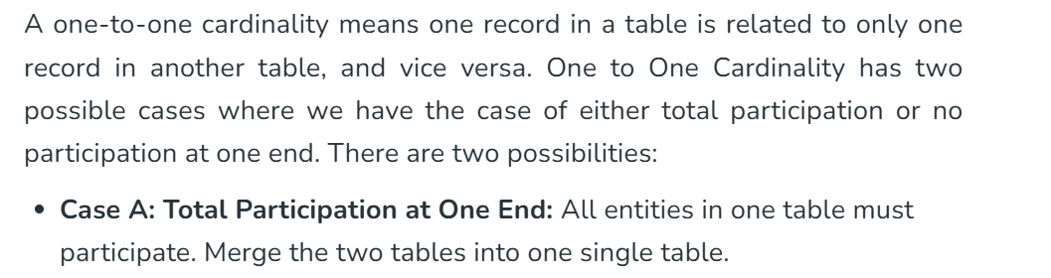
1. One-to-One Cardinality

Slide 62
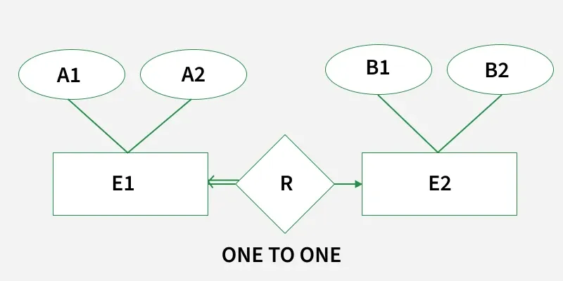
Note: Binary relationship with 1:1 cardinality will have 2 table if partial participation of both entities in the relationship. If atleast 1 entity has total participation, number of tables required will be 1.

Slide 63
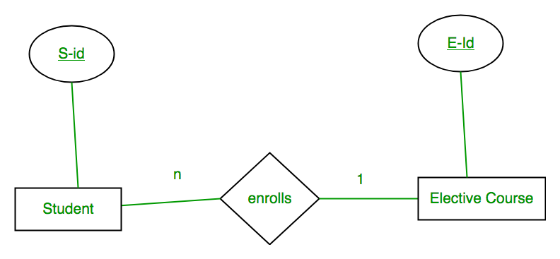
Case 3: Binary Relationship with n: 1 cardinality

Slide 64


Slide 65
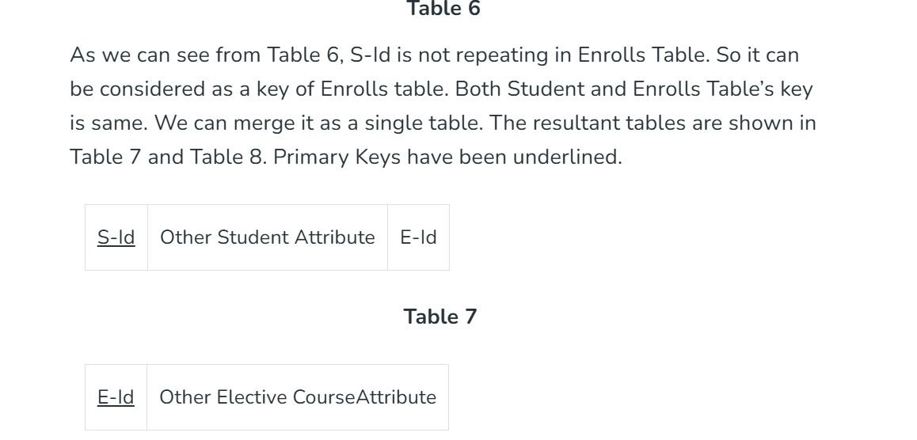

Slide 66
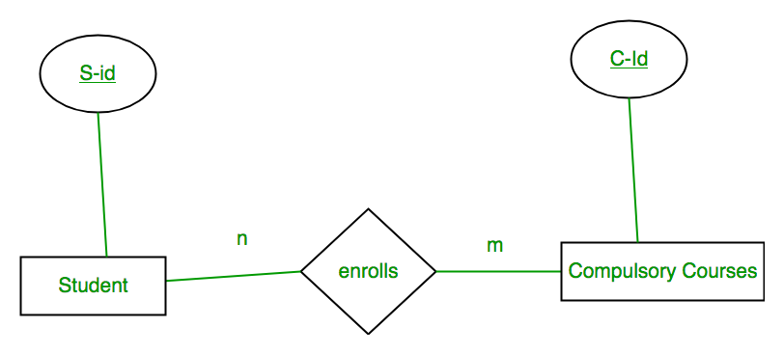
Case 4: Binary Relationship with m: n cardinality

Slide 67


Slide 68
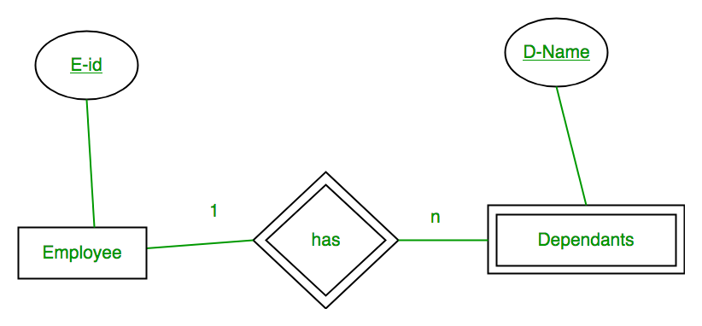
Case 5: Binary Relationship with weak entity

Slide 69
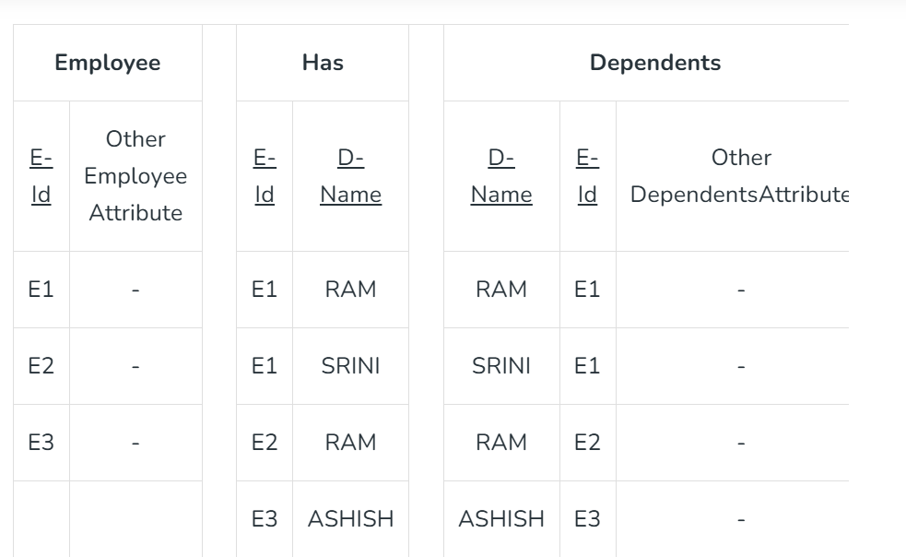

Slide 70
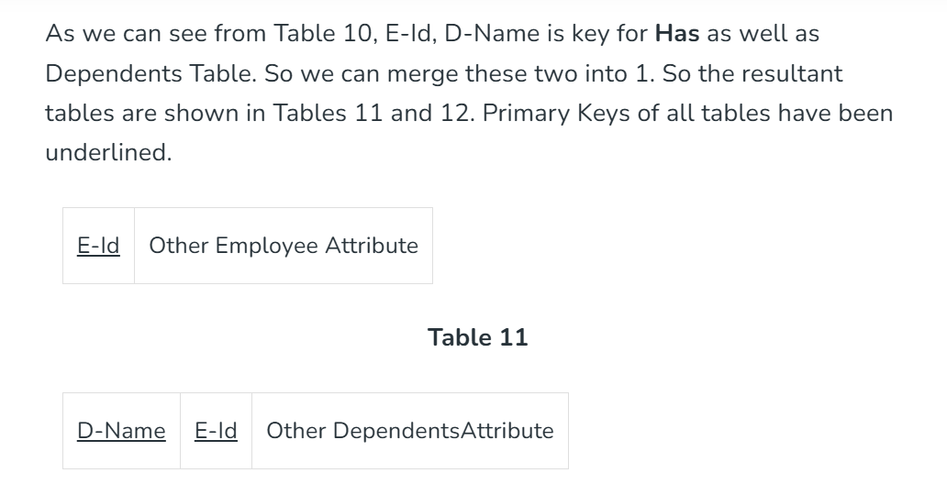

Slide 71
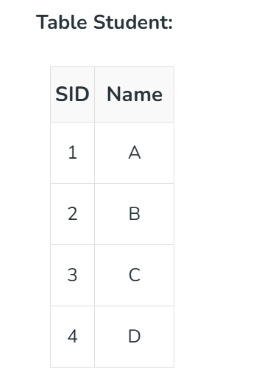
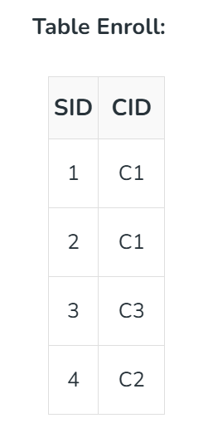
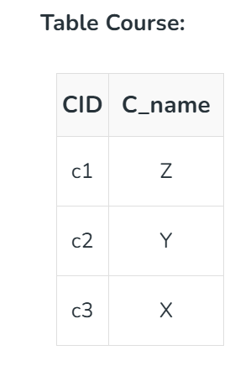

Slide 72
